Slide 1
Computational Thinking
Module 01

Slide 2
What is computational thinking?

Slide 3
Computational thinking is a way of logically breaking down a problem so that we can develop a step-by-step solution.

Slide 4
Computational Thinking
Key principles of computational thinking include the following:
Decomposition
Pattern recognition
Abstraction
Algorithms

Slide 5
What is decomposition?

Slide 6

Decomposition
We use decomposition to break down a problem down into smaller, more manageable parts.
Notes:
shutterstock_1724405443

Slide 7
What is pattern recognition?

Slide 8

Pattern recognition
Once a problem is broken down, we use pattern recognition to find similarities and patterns among the smaller parts. This helps us solve the problem more efficiently.
Notes:
shutterstock_1724405443

Slide 9
What is abstraction?

Slide 10

Abstraction
Once patterns are recognized, we use abstraction to focus on important and relevant information and filter out what is not needed to solve our problem.
Notes:
shutterstock_1724405443

Slide 11
What is an algorithm?

Slide 12
After the other steps are complete, it is time for a plan. An algorithm is a set of step-by-step instructions that provide a solution to the problem.

Slide 13
How to Solve a Puzzle
01
Choose a puzzle
02
Flip all pieces face up
03
Find all the edge pieces.
04
Use edge pieces to create frame.
05
Group the remaining pieces by color.
06
In each color group, find the special pieces
07
Break down the image into small sections
08
Work on one section at a time, paying attention to colors and special pieces
09
Join completed section inside of frame.

Slide 14
How do we apply computational thinking to solve coding challenges?

Slide 15
Our Problem-Solving Tools of the Trade
User stories and acceptance criteria help us clarify the scope of the problem and break it down into manageable parts.
EPIC
User Story
User Story
Acceptance Criteria 1
Acceptance Criteria 2
Acceptance Criteria 1
Acceptance Criteria 2
Task
Task
Task
Task

Slide 16
A user story helps us identify the end goal and communicate how the solution will meet that goal.

Slide 17

Identifying Goals and Rewards: User Stories
A user story follows a specific format:
As a [user],
I want to [do something],
so that I can [realize a reward].
[user] | The end user or customer.
[do something] | Identifies the goal the solution must address.
[realize a reward] | Describes when the goal is met.

Slide 18
Acceptance criteria provide the conditions that must be met for the goal to be accomplished and the solution accepted by the user.

Slide 19
Getting Specific: Acceptance Criteria
Acceptance criteria define what specific tasks or functions must be done to solve the problem presented in the user story and have a clear pass or fail result. All criteria must pass for the solution to be accepted.
EPIC
User Story
User Story
Acceptance Criteria 1
Acceptance Criteria 2
Acceptance Criteria 1
Acceptance Criteria 2
Task
Task
Task
Task

Slide 20
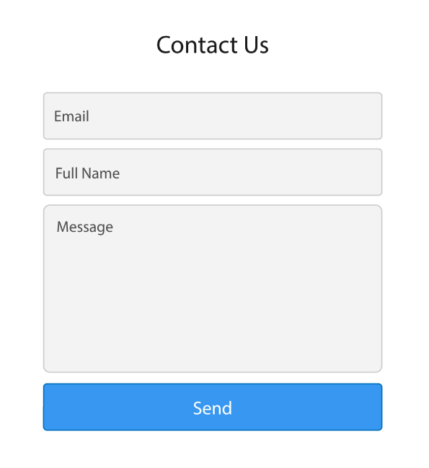
Getting Specific: Acceptance Criteria
For example: It’s done when there is a contact form that includes a text box for a visitor’s name and email.
Notes:
shutterstock_1433571035.png

Slide 21
The solution is a set of step-by-step instructions that address each of
the acceptance criteria and clearly meet the user’s goal and reward as described in the user story.

